Slide 1


Sentimental analysis
By : Iqra shaikh

Slide 2


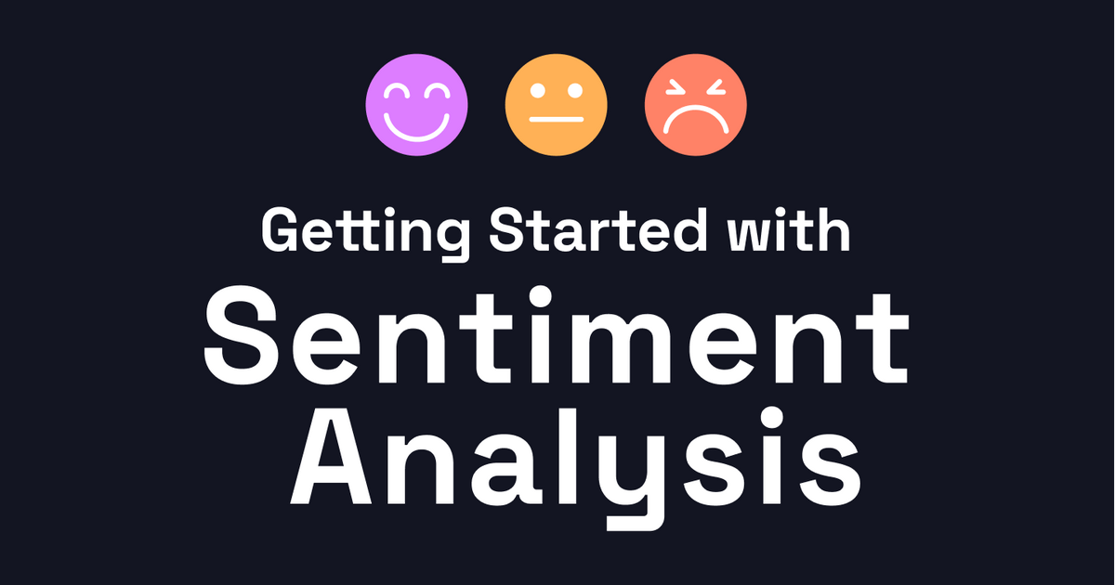
Amazon Sentimental Analysis:
Problem Statement: Amazon Sentiment Analysis
In the digital age, online customer reviews are a critical source of feedback for businesses and consumers alike. Amazon, one of the largest e-commerce platforms, hosts millions of product reviews that contain valuable insights into customer sentiment. However, manually analyzing these reviews to understand customer opinions is impractical due to the vast volume of data.
The goal of this project is to develop a sentiment analysis model that can automatically classify Amazon product reviews into categories such as positive, neutral, or negative. This will help businesses understand customer satisfaction, identify areas of improvement, and make informed decisions about product offerings.

Slide 3
Work flow:-
1. Data Collection
Scrape Reviews: Use web scraping tools (e.g.,BeautifulSoup) to extract Amazon reviews.
Focus on fields such as:
review_title
review_summary
review_date
rating
Save Data: Store the data in CSV or database format for further analysis.
2. Results Analysis & Visualization
Visualize Sentiments:
Use word clouds, histograms, or pie charts to show the distribution of sentiments (positive, neutral, negative).
Error Analysis:
Analyze misclassifications and model performance on test data.

Slide 4
3. Data Preprocessing
Text Cleaning:
Remove HTML tags, special characters, and extra spaces.
Convert text to lowercase.
Remove stopwords (common but unimportant words like "the", "is").
Tokenization:
Split the review text into individual words (tokens).
Stemming/Lemmatization:
Apply stemming (we are using this) to reduce words to their root forms (e.g., "running" → "run").
Feature Extraction:
Convert the review text into a numerical format using CountVectorizer or TF-IDF.

Slide 5
4. Sentiment Labeling
Label Based on Ratings:
Define sentiment categories based on the star rating:
Positive: Ratings
Neutral: Ratings
Negative: Ratings
5. Model Development
Split Data: Divide the dataset into training and testing sets (e.g., 80% training, 20% testing).
Preprocess Features: Apply:
CountVectorizer on text data.
MinMaxScaler to normalize data if needed.
Choose Models:
Decision Tree, RandomForestClassifier (we are using this), Logistic Regression, XGBoost, etc.
Train the Model:
Fit the model to the training data.

Slide 6
6. Model Evaluation
Cross-Validation: Apply k-fold cross-validation to ensure model stability.
Evaluation Metrics:
Use accuracy, precision, recall, F1-score, and confusion matrix to evaluate the model.
Hyperparameter Tuning:
Use GridSearchCV or RandomSearchCV to optimize model parameters.
7. Model Saving
Export the Model:
Save the trained model using pickle for deployment.
8. Deployment
Streamlit App:
Build an interactive web app using Streamlit for real-time sentiment prediction.
Take user input (a review), preprocess the text, and predict the sentiment using the saved model.

Slide 7
EDA(EXPLORATORY DATA ANALYSIS):-

Slide 10
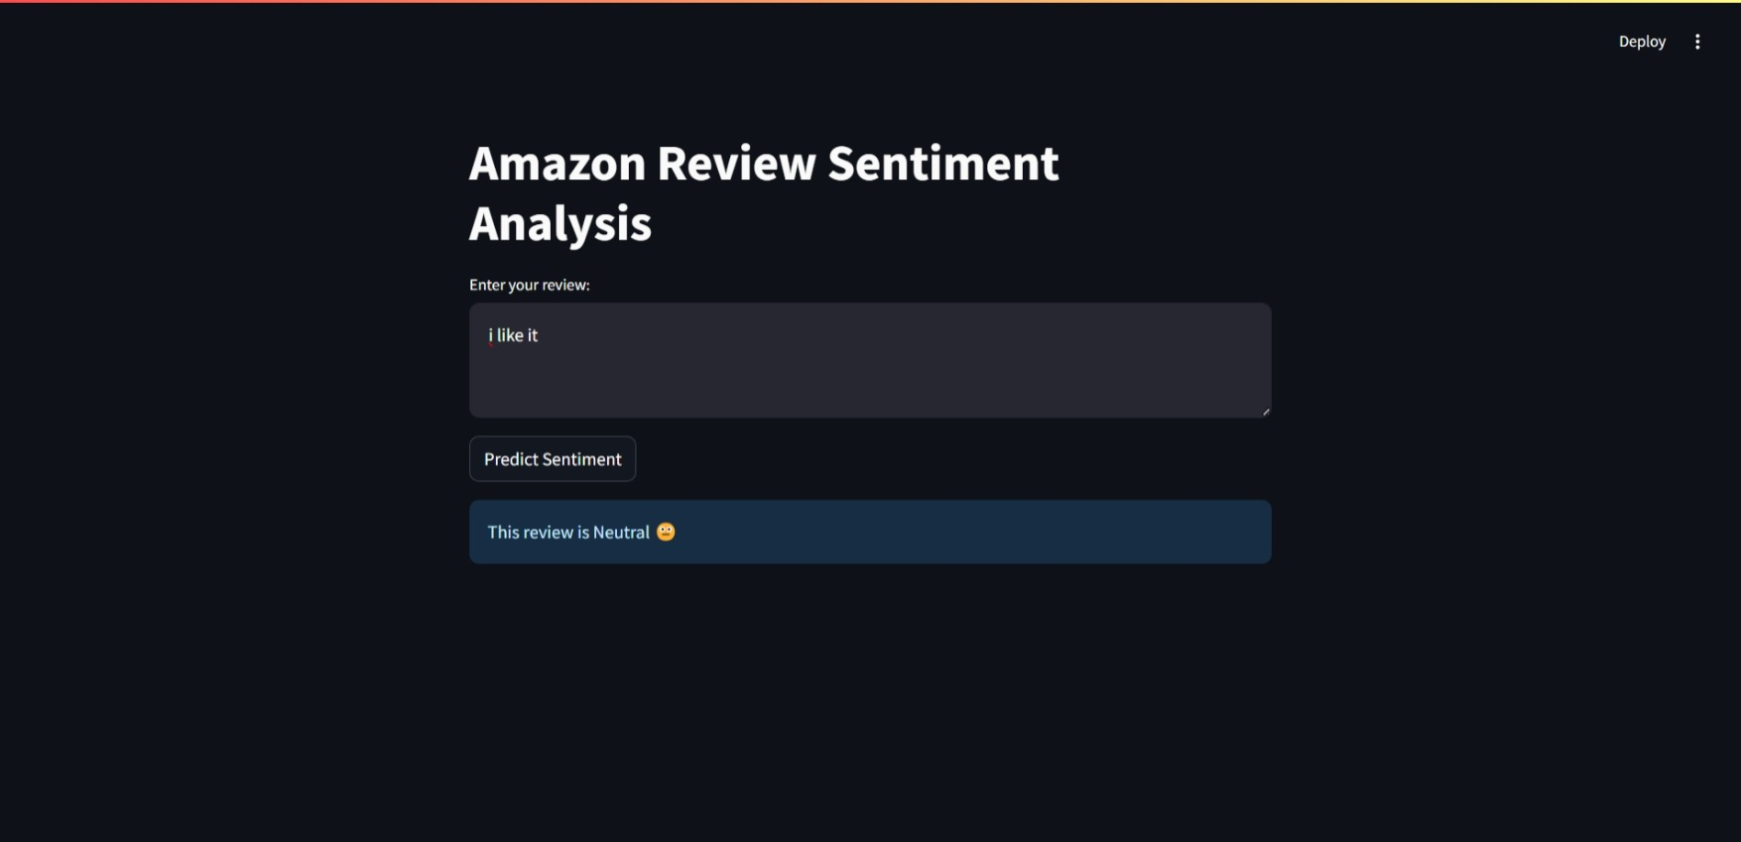
DEPLOYMENT:

Slide 11
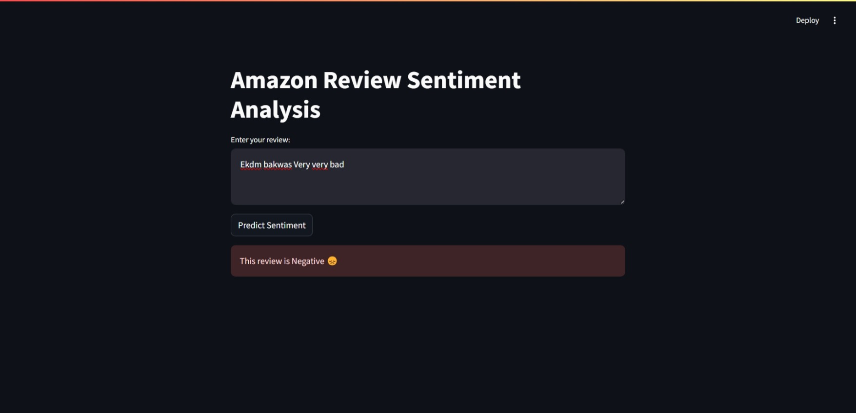
NEGATIVE REVIEW:

Slide 12
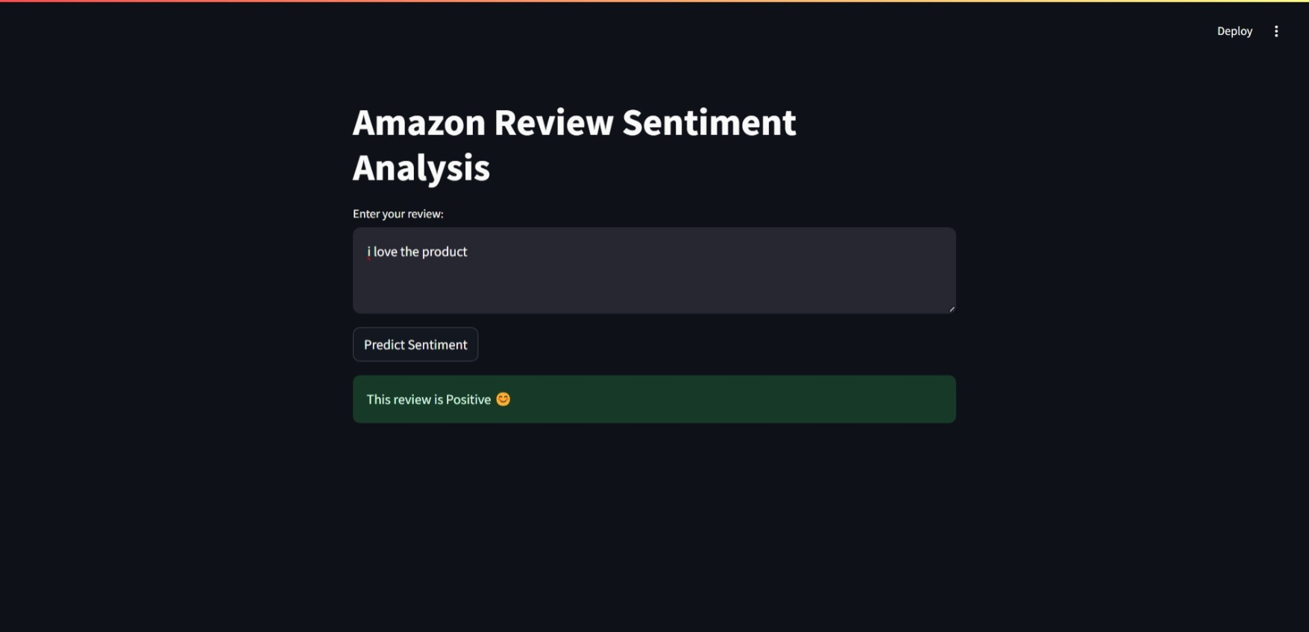
POSITIVE REVIEW:

